Slide 1
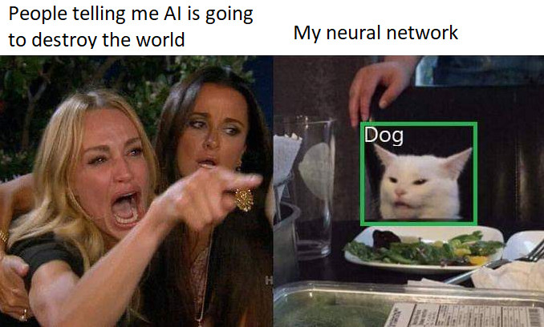


Introduction to Computer Vision
Dhanush Giriyan

Slide 2
What is Deep Learning all about?
Using “deep” neural networks to extract features from a large collection of data.
Perform a series of non-linear transformations on data to obtain an output.
Weights of the network are trained using gradient-based optimization algorithms, like RMSProp, Adam, and their variants.
Optimization is done while minimizing a loss function.

Slide 3
Classes of Learning Algorithms
Supervised Learning
Unsupervised Learning
Semi-Supervised Learning
Reinforcement Learning

Slide 4
Supervised Learning - a first step towards true AI…
Given: Large amounts of labeled data.
Objective: Minimize the error between predicted values and actual values. Achieved using optimizers.
Can be used for classification, regression, denoising, and almost every other application you come across.
Used with all kinds of data: Tabular, images, videos, text, audio, etc.

Slide 5
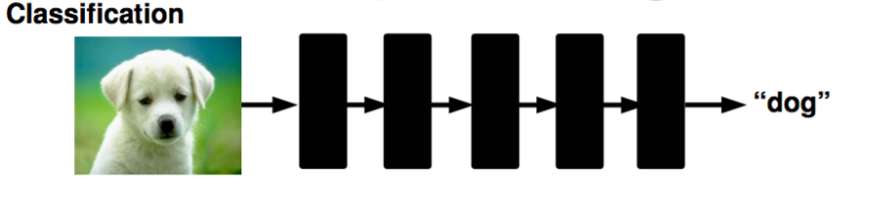
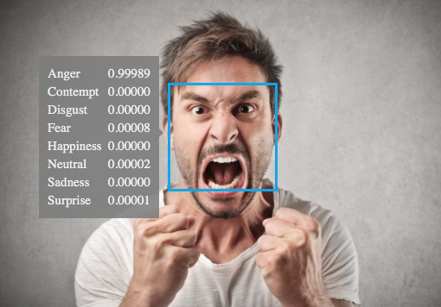
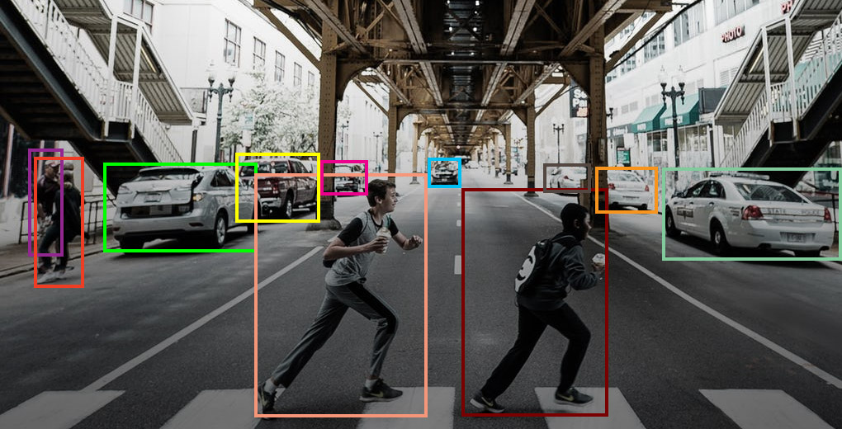

Slide 6
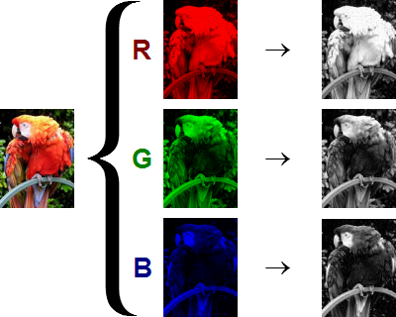
Image Data
Images = Arrays
Images are made up of Channels
Gray scale (black and white) images have one channel, while RGB (color) images have 3 channels (one for each).

Slide 7
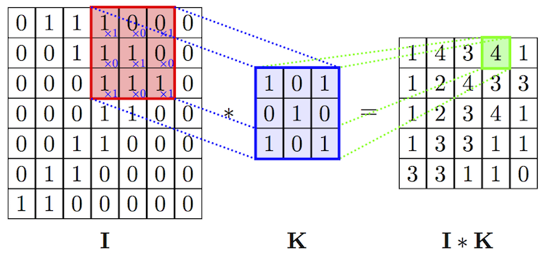
Convolutional Neural Networks – The powerhouse of Computer Vision
CNNs derive their strength from the Convolution operation.

Slide 9
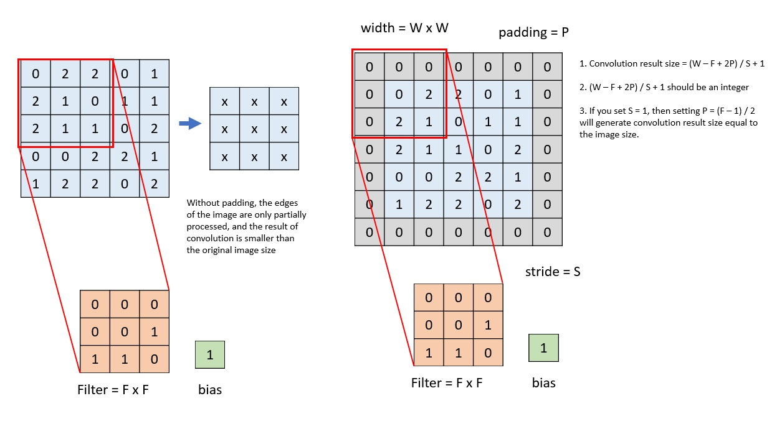

Slide 10
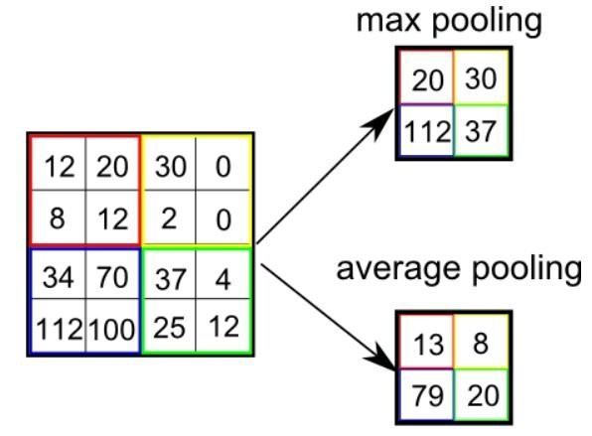
Pooling Layers

Slide 11
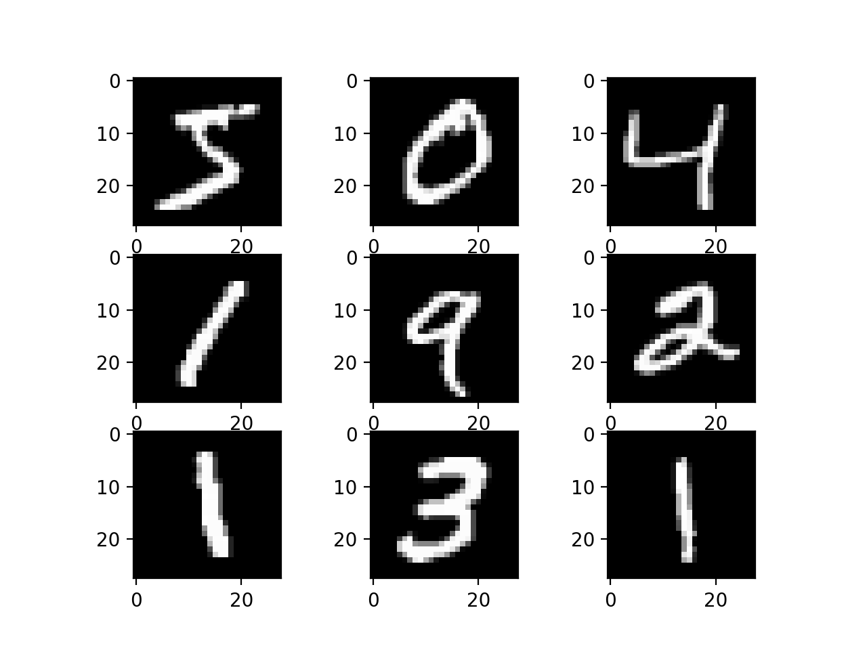
MNIST Dataset
Handwritten digits dataset
60,000 training data points
10,000 testing data points
Each image is 28 x 28 x 1 (gray scale)

Slide 12
Train a model!
https://colab.research.google.com/drive/1Sw-6d7AMMATzK81qox5OfwDClV5b_7LV?usp=sharing

Slide 13
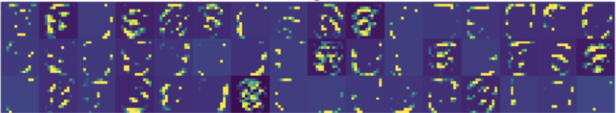
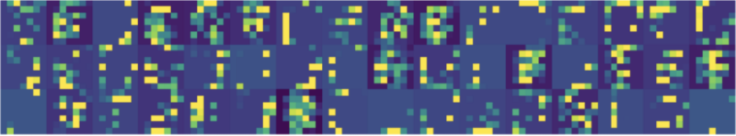
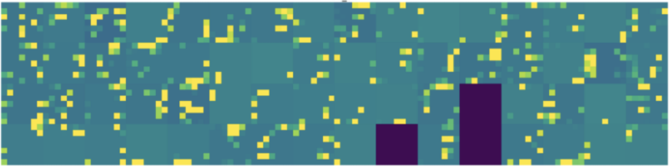
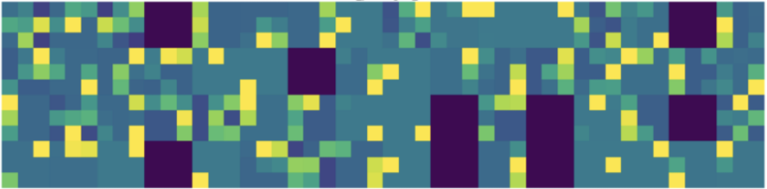
What exactly did the model learn??
Increasing level of detail in features
Depth of layer in network architecture

